Slide 1
Pokerbots 2023
Lecture 3: Game Theory

Slide 2
Announcements
Lecture #4: Guest Lecture by Noam Brown
Creator of the world’s most successful pokerbots Libratus and Pluribus.
Wednesday, 01/18 still in 6-120 from 10am - 11:30am
Feel free to invite friends
Poker Afternoon #2 – with Noam Brown
Tuesday 01/17 (not Wednesday as in syllabus) from 3pm to 5pm
Location: TBD
Team forming
Sponsors: info in syllabus

Slide 3
Weekly Tournament:
Tonight @ 11:59pm EST

Slide 4
pkr.bot/fevent-survey
poll on final event networking and awards ceremony

Slide 5
First Game

Slide 6
First game
Submit an integer between 0-1000 inclusive
Winner is the closest guess to 2/3 of the average submission (a tie is broken randomly)
Prize: today’s giveaway
pkr.bot/beauty

Slide 7
Agenda
Types of games
What is a game?
Pure and mixed strategies
Nash equilibria
Applications to poker

Slide 8
Types of Games

Slide 9
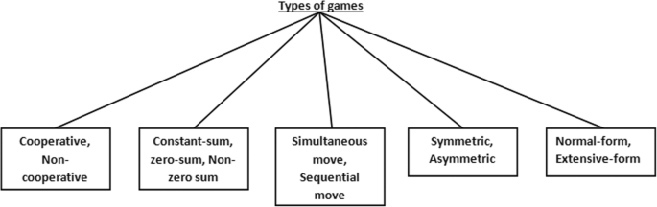

Slide 10
What is a game?

Slide 11
Definition
We generally only consider two-player zero-sum games; we will refer to these as simply games.
Examples: RPS, tic-tac-toe, (chess? poker??)
Notes:
Discuss what the terms mean (2-person and zero-sum). Note that “game” means a broader thing and we are just using shorthand.
Examples: rocks paper scissors, pick the bigger number, chess/poker [will flesh out later].
Rocks paper scissors will be guiding example through a lot of this first part

Slide 12
Formalized
A game between players 1 and 2 consists of a pair of strategy sets S₁ and S₂, and a utility function u : S₁ x S₂ ⟶ R. Players submit strategies simultaneously. Player 1 seeks to maximize u, and player 2 seeks to minimize u.
Think of utility as chips. This means players want to submit actions that have the highest payout.
Player 2 is minimizing since we're talking about zero-sum games.

Slide 13
Pure and mixed strategies

Slide 14
Pure and mixed strategies
There are only 3 pure strategies in RPS, but infinitely many mixed strategies
A mixed strategy is described by a probability distribution over pure strategies:
Example:
P(rock) = 0.4
P(paper) = 0.3
P(scissors) = 0.3
Mixed strategies show us the power of randomness
Notes:
Discuss what this even means
What are mixed strategies in MNIBTY? [ask class]

Slide 15
Matrix form games
Suppose the strategy sets S₁ and S₂ consist of probability distributions over a finite list of pure strategies. Also, suppose that the utility function is linear. Then, we can write our game in matrix form, with utility function shown.
 | Rock | Paper | Scissors
Rock | 0 | -1 | +1
Paper | +1 | 0 | -1
Scissors | -1 | +1 | 0
Notes:
RPS is a symmetric game

Slide 16
Revisiting the first game
Notes:
Give stats (%0, average, ⅔ average, winner)

Slide 17
The Keynesian beauty contest
No rational player would play above 2/3 · 1000 = 667
Hence, no rational player would play above 2/3 · 667 = 445
What happens if we continue this logic?
What would "rational" players play?
Notes:
A note on theory vs practice! blotto

Slide 18
Dominance
We say that strategy A dominates strategy B if playing A is always a better idea
u(A, O) ≥ u(B, O) for all player 2 strategies O
Second-order dominance: replace “is always a better idea” with “is always a better idea, if our opponent does not play dominated strategies”
Notes:
Replace better with “at least as good”
Note that there are edge cases where strategy A is not dominated by strategies B or C, but is dominated by some mixed strategy in B and C.
No dominance in RPS

Slide 19
Dominance Example
What does this mean?
 | C (c) | D (d)
A (a) | (+3, -3) | (+2, -2)
B (b) | (+1, -1) | (-1, 1)
 | C (c) | D (d)
A (a) | (+3, -3) | (+2, -2)
B (b) | (+1, -1) | (-1, 1)
 | C (c) | D (d)
A (a) | (+3, -3) | (+2, -2)
B (b) | (+1, -1) | (-1, 1)
 | C (c) | D (d)
A (a) | (+3, -3) | (+2, -2)
B (b) | (+1, -1) | (-1, 1)

Slide 20
Nash equilibria

Slide 21
An equilibrium is a set of strategies, one for each player, such that nobody has an incentive to switch.

Slide 22
Nash equilibrium examples
0 is an equilibrium for the Keynesian beauty contest
1/3 rock, 1/3 paper, 1/3 scissors is an equilibrium for RPS
Notes:
Talk about how there is a pure strategy equilibrium for beauty contest, but what about RPS and MNIBTY?

Slide 23
Solving the equilibrium for RPS
r + p + s = 1; r, p, s ≥ 0
Expected value of opponent playing each case
Solve p - s = s - r = r - p to get r = p = s = 1/3. This guarantees us at least 0
 | Rock (r) | Paper (p) | Scissors (s)
Rock (r) | 0 | -1 | +1
Paper (p) | +1 | 0 | -1
Scissors (s) | -1 | +1 | 0
EV | Opponent | p-s | s-r | r-p
Notes:
r,p,s are our probabilities of playing rocks paper and scissor

Slide 24
Why p - s = s - r = r - p?
Suppose opponent plays the optimal counterstrategy against our r, p, s strategy
Opponent minimizes the utility function amongst their three options:
min_{args}(p - s, s - r, r - p)
We play the strategy that maximizes the utility function even against the optimal counterstrategy:
max_{r, p, s}(min_{args}(p - s, s - r, r - p))

Slide 25
Asymmetric game
Toy game for illustration: I am choosing battle plans against the enemy
We notice two things: the game isn't symmetric, and that we see a lot of positive values.
 | Full Defense | Defend in shifts
Charge | 0 | +3
Sneak attack | +1 | -1
Notes:
This game is themed around military battle plans, because game theory was actually developed significantly by military strategists at the RAND Corporation, a large think tank, during the 1950s!
Notes on this method: it’ll give you garbage if dominated strategies are in there. “Can always do this” via LP duality

Slide 26
Asymmetric game mixed strategy equilibrium
Setting this up, we start with c + s = 1; c, s ≥ 0
Solving, we get c = 0.4, s = 0.6, f = 0.8, d = 0.2
“Value” of the game to us is 0.6
 | Full Defense (f) | Defend in shifts (d) | EV | Opponent
Charge (c) | 0 | +3 | 3d
Sneak attack (s) | +1 | -1 | f-d
EV | Opponent | s | 3c-s

Slide 27
Existence of Nash equilibria
Theorem (Nash, 1951): Every finite game has a Nash equilibrium in mixed strategies.
Proof: Topology (uses fixed point theorem).
Notes:
Fixed point theorem

Slide 28
Applications to poker

Slide 29
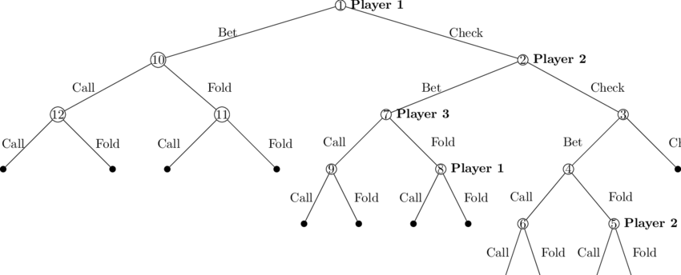
Game Tree

Slide 30
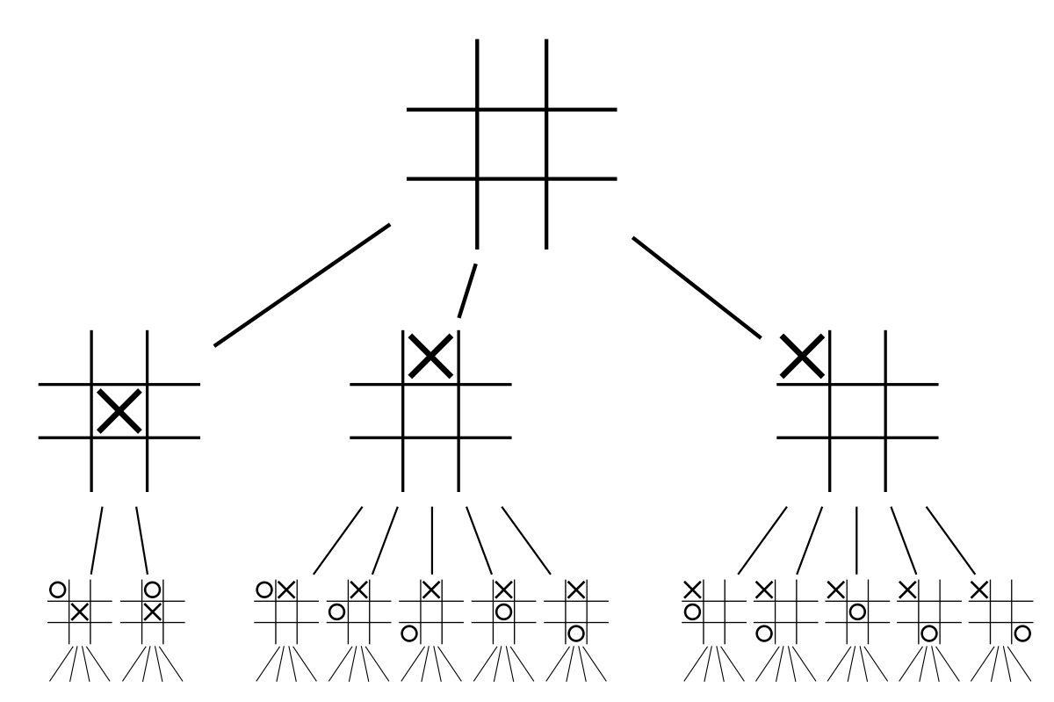
Extensive form games
Notes:
How to deal with sequential games?
Discuss chess, backwards induction
Define extensive form

Slide 31
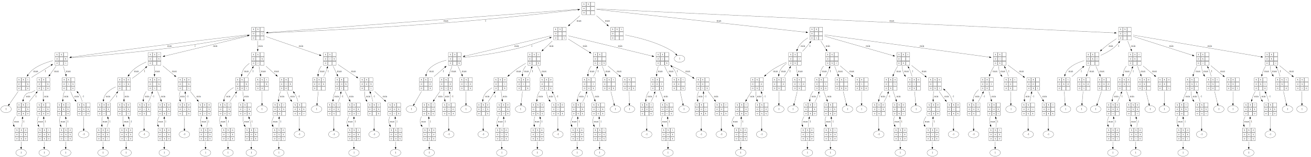
Tic Tac Toe Full Extensive Form

Slide 32
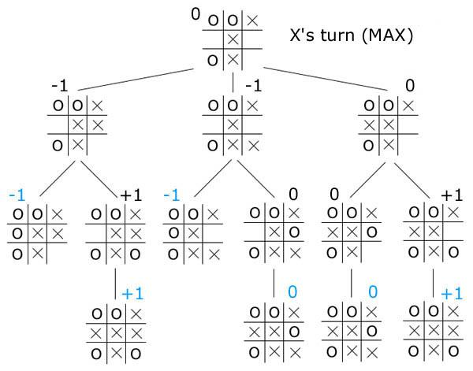
Backwards induction
Black are the determined payouts based on players acting rationally
Blue are the leaves - the terminal states of the game
Follow the game tree up (backwards) to find the state's value
Notes:
How to deal with sequential games?
Discuss chess, backwards induction
Define extensive form

Slide 33
Backwards induction
Looking at the leaf states first, I see -1s in the left 2 branches, leaving their parents as -1.
The rightmost branch has payouts 0 and 1. Following this up the tree, we get 0 for the black value.
Finally, all together X should try to play for 0 (tie), and does so by putting x in left center.

Slide 34
Conversion to normal form
Every extensive form is also a normal form (matrix) game
Notes:
Problem: exponential blowup! Actually it’s worse than that, because the game tree is ALREADY exponentially large.

Slide 35
Conversion to normal form
Every extensive form is also a normal form (matrix) game
Mapping: each pure strategy (row/column) is a complete set of instructions for what to do at each node
Example: in poker, each pure strategy would be a dictionary which maps the game_state to a unique action
Notes:
Problem: exponential blowup! Actually it’s worse than that, because the game tree is ALREADY exponentially large.

Slide 36
Implications
Poker has a Nash equilibrium - it's a finite game that satisfies the conditions
Can we use backwards induction to solve for it? Can we still use the same type of game tree?
How is poker different from tic-tac-toe? RPS? Chess?

Slide 37
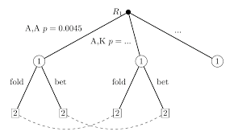
Adding in imperfect information and randomness
Notes:
Same idea, except now we collapse some of the nodes from the perspective of one of the players.

Slide 38
Imperfect Information and Randomness
Randomness: Don't know where in the game tree you're moving next
Imperfect: Don't know what node you're currently at since your opponent's hole cards are hidden (information sets)
Together, this leads to a really nice property of poker. The general game tree movements (bet/fold/call) are known, but the definite game state isn't. Imperfect information makes games fun!

Slide 39
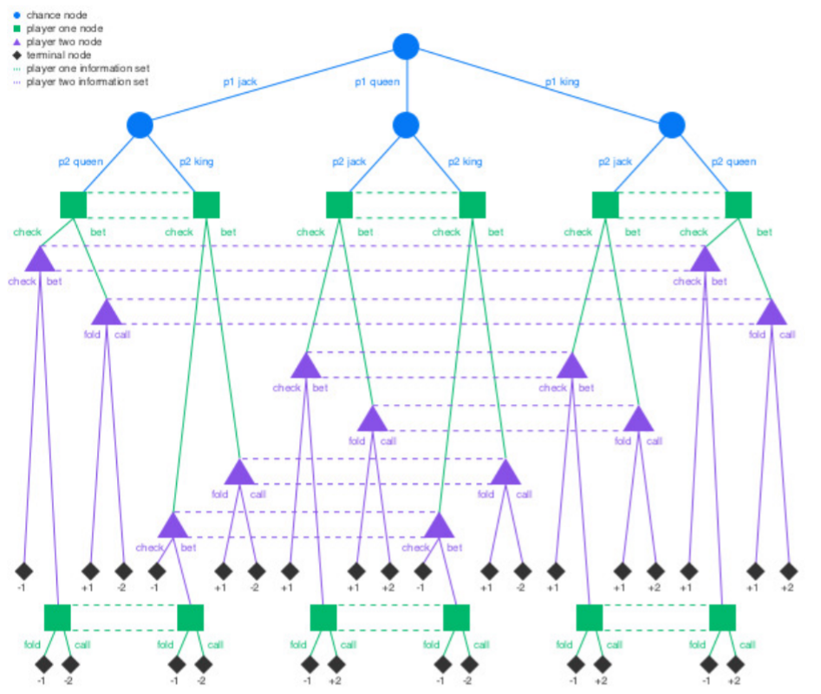
Kuhn Poker Game Tree

Slide 40
Kuhn Poker Game Tree
Breakdown
Each player antes 1
Each player is dealt one of the three cards, and the third is put aside unseen.
Player one can check or bet 1.
If player one checks then player two can check or bet 1.
If player two checks there is a showdown for the pot of 2 (i.e. the higher card wins 1 from the other player).
If player two bets then player one can fold or call.
If player one folds then player two takes the pot of 3 (i.e. winning 1 from player 1).
If player one calls there is a showdown for the pot of 4 (i.e. the higher card wins 2 from the other player).
If player one bets then player two can fold or call.
If player two folds then player one takes the pot of 3 (i.e. winning 1 from player 2).
If player two calls there is a showdown for the pot of 4 (i.e. the higher card wins 2 from the other player).

Slide 41
Poker Nash equilibrium and use
Poker has a Nash equilibrium that has EV 0
The matrix is doubly exponential in size - incomputable
Does “play good poker” reduce to “play the equilibrium strategy”?
Exploitative strategies as alternatives
Notes:
Talk about tractability, approximation methods, and what we mean by quasi-uniqueness (zero sum games).
In practice, Nash should defeat things not in the support of the Nash. but this is more of an empirical truth [Libratus], mention RPS. Certainly an exploiter can outperform a Nasher in this tourney.

Slide 42
Second Game
Notes:
https://www.youtube.com/watch?v=hRIXXCe0Hi0

Slide 43
Second game
Entry fee: wager 20 scrimmage server ELO points
Parse the last 4 digits of your MIT ID as an integer 0-9999
Winner is the highest integer (a tie is broken randomly)
Prize: all wagered ELO points
pkr.bot/lemons

Slide 44
Applied game theory
Notes:
https://www.youtube.com/watch?v=hRIXXCe0Hi0

Slide 45
The MIT ID game
Suppose rational players would only play if their number is ≥X
Students might submit only if ≥9000
But if only ≥X is submitted, then X is the smallest value and shouldn't be submitted
Why submit 9000?
Continue this logic (nth order dominance)
Why submit 9001? 9002?
Notes:
A note on theory vs practice!

Slide 46
Adverse selection
Occurs anytime “buyer” and “seller” have asymmetric information
Market for cars: suppose there are used cars with private value distributed uniformly between $1000 and $10000. What should the market price be?
What would car owners do? Then what happens?
Notes:
Occurs all the time in finance. Used cars example. Econ $20 bill joke.

Slide 47
Sources of adverse selection in poker
First action when betting (differential check to the preflop aggressor)
Multiple bets in a row (what types of hands do this?)
Being in the later stages of the round (why would are they still in the pot?)
Others?
Notes:
Ask for audience here/
Literally just being in the game at the flop, etc

Slide 48
When I bet, am I happy with my bet conditioned on my opponent calling?

Slide 49
Adverse selection and determinism
Suppose I have the following deterministic betting strategy:
All-in when I have a top X% hand
How can my opponent exploit me?

Slide 50
Coding Reference-3 Bot
Notes:
https://www.youtube.com/watch?v=hRIXXCe0Hi0

Slide 51
Beauty Contest Winner
yadavps

Slide 52
MIT ID Contest Winner

